Slide 1









USER BEHAVIOR AND REVENUE INSIGHTS
By Moyin, Ridwan & John

Slide 2
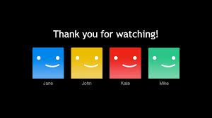
Our team
Moyin
Ridwan
John

Slide 3

OVERVIEW
Imagine millions of users streaming their favourite shows, making choices that shape Netflix’s success. What if we could uncover hidden patterns behind their behaviour? This project explores just that, analyzing user engagement, revenue trends, and growth opportunities.

Slide 4

Methodology
Where did our data come from?
Sourced from Kaggle
Ridwan cleaned and prepared the data using Microsoft Excel, ensuring accuracy.
Moyin and Mr. John explored SQL queries to extract meaningful patterns.
Moyin built a Power BI dashboard to bringing the data to life with visuals.

Slide 5
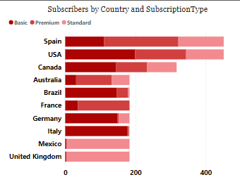
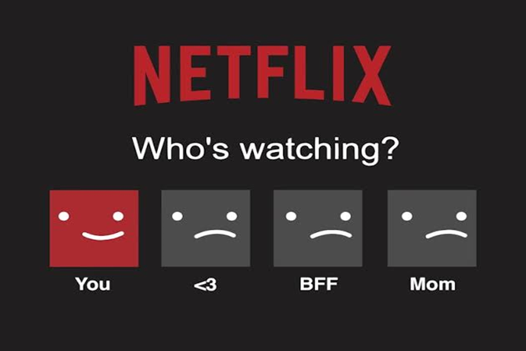
Subscribers overview
2,500 active users globally.
Hotspots: USA and Spain lead in subscriptions!
Who’s watching? Middle-aged users dominate, especially on Basic Plans.

Slide 6

Subscription Trends – Who Stays & Who Leaves?
Retention & Churn Insights
Basic Plan Struggles:
Churn Rate: 39.06%
Retention Rate: 40.28%
What devices are popular? Laptops & smartphones are leading choices!

Slide 7
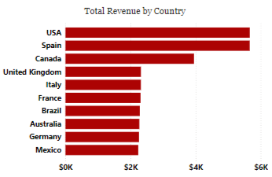
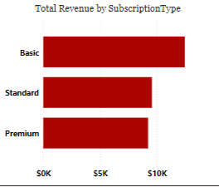
Revenue Insights – Where Does the Money Come From?
Breaking Down the Numbers
Total Monthly Revenue: $31,270
Top Revenue Markets: USA, Spain, and Canada.

Slide 8
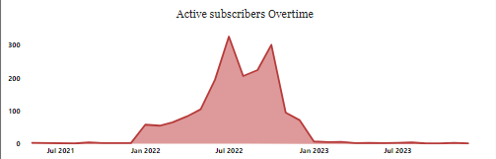
Observation
The USA & Spain are Netflix’s power markets—let’s keep them engaged!
Basic Plans bring the cash, but we need to reduce churn.
Most users prefer mobile & laptop streaming—optimization is key!
Subscriber spikes align with major content releases—content drives engagement.

Slide 9
Recommendation
What should Netflix consider next?
Reduce churn in the Basic Plan – Implement loyalty programmes and offer exclusive perks.
Utilise content to foster growth – Plan strategic release timings for improved retention.
Enhance the mobile experience – Optimise for mobile phones and laptops.
Concentrate on key markets – Tailor marketing efforts to the USA and Spain. 🇺🇸🇪🇸
Target middle-aged users – Develop personalised campaigns to keep them engaged. ain. 🇺🇸🇪🇸
Target middle-aged users – Develop personalised campaigns to keep them engaged.

Slide 10
Conclusion
Our analysis shows that user behavior directly impacts revenue.
With data-driven strategies, Netflix can boost engagement & retention.
The power of analytics transforms business decisions into real success.

Slide 11
Tools & Teamwork
Technologies Used:
Microsoft Excel (Data Cleaning)
SQL (Data Analysis)
Power BI (Dashboard & Visualization)
👥 Team Contributions:
Ridwan: Data sourcing & cleaning.
Moyin: Team lead, SQL analysis supervision, and Power BI dashboard.
Mr. John: SQL query execution.

Slide 12
Thank
You

